Slide 1
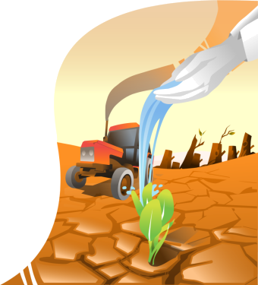


Climate Change and Food Security
Impacts of Climate Change on Food Security

Slide 2

LEARNING OBJECTIVES
Describe potential impacts of climate change on food security.
Understand how climate change effects fit into the array of food security determinants at local and global level.

Slide 3
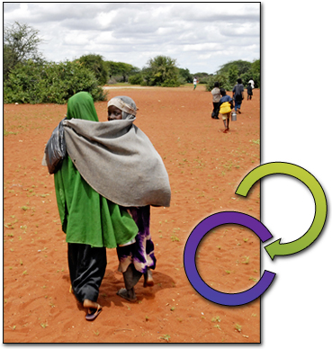
INTRODUCTION
Climate change happens in different ways:
increased climate variability
gradual changes in temperature and precipitation
increased frequency and intensity of extreme events.
Climate
Change
How does all of that impact food security?
Food
Security
Notes:
Notes for trainers:
Climate change happens in different ways, ranging from increased climate variability and gradual changes in temperature and precipitation, to increased frequency and intensity of extreme events.
In this lesson you will see some examples of how climate change impacts on food insecure and vulnerable people.
You will also look at the interactions between climate change and food security determinants at global level.

Slide 4
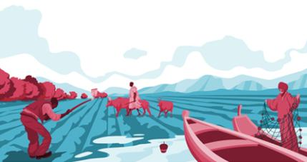
IMPACTS OF CLIMATE CHANGE ON AGRICULTURE
Impacts on the agricultural sector:
- Availability of good quality water
- Habitats and species distribution
- Timing and length of growing season
- Distribution of agro-ecological zones
Ecosystem stresses
Notes:
Notes for trainers:
Let’s focus on the agricultural sector, including crops, forests, livestock and fisheries.
Can you imagine how changes in climatic conditions constitute major challenges for agriculture productivity?
There will be changes in…
- Availability of good quality water
- Habitats and species distribution
- Timing and length of growing season
- Distribution of agro-ecological zones
Ecosystem stresses (erosion by water and wind, acidification, salinization, biological degradation)

Slide 5
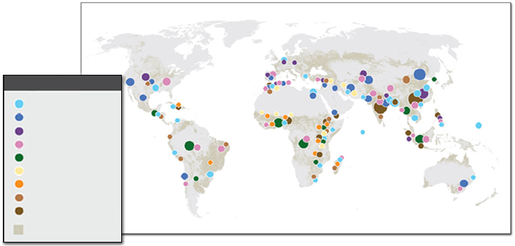
IMPACTS OF CLIMATE CHANGE ON AGRICULTURE
Global distribution of risks for agricultural production systems
Floods/Sea level rise
Water scarcity
Pollution
Loss of biodiversity
Deforestation
Desertification/Droughts
Loss/low soil fertility
Erosion
Land scarcity
Crop land
Notes:
Notes for trainers:
Warming may extend the limit of agriculture in the northern hemisphere. It is anticipated that key agricultural systems will need to cope with new stresses and risks. The map on the next slide shows the global distribution of risks associated with main agricultural production systems. Climate change is exacerbating these risks.
Major expected impacts of climate change risks on agriculture emphasize increased regional disparities between countries.

Slide 6
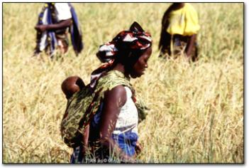
IMPACTS OF CLIMATE CHANGE ON VULNERABLE PEOPLE
People depending on climate-sensitive livelihoods and poor or marginalized groups, with limited access to resources and information sharing, are the most affected by climate change.
Notes:
Notes for trainers:
Climate change affects everyone.
But worst hit will be those who are already vulnerable.
Climate change impacts affect people differently depending on their livelihoods and socio-economic status.
Information picture: Women in rural sub-Saharan Africa are one of the groups most vulnerable to climate change. They depend on rainfed agriculture which is highly climate sensitive. Further, women are among the poorest and most marginalized.

Slide 7

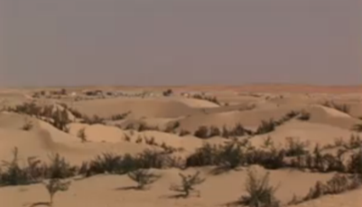
IMPACTS OF CLIMATE CHANGE ON VULNERABLE PEOPLE
Examples showing climate change impacts on vulnerable people:
CASE 1: Creeping deserts in Mauritania
- Water
- People
- Scarce water
- Water needs
- Causes
Notes:
Notes for trainers:
The next slides show a couple of examples showing climate change impacts on vulnerable people. The video in Case 1 illustrates the consequences of water scarcity and loss of suitable land for agriculture on the life of traditional nomadic herders in Mauritania. Please watch the video.
Case 1 video: http://youtu.be/ghBE_abOGmM
Key points from the video:
Water
People at the fringes of deserts, such as nomads and herders, depend on water resources for humans and livestock.
Finding water resources is already difficult, but climate change makes it more difficult.
People
The desert is expanding.
Some areas cannot support the people anymore.
Some give up nomadism to settle near water sources.
Scarce water
Water resources have become scarce during the last decades. This is a major problem in the region.
Water needs
Water is needed for two main purposes: for the people themselves and for the herds. Thus, water resources are responsible for food security in two ways; as diet and source of income.
Causes
Climate change leads to the expansion of the desert and increased water scarcity. This threatens food security. Note that climate change is not the only reason that water is becoming scarce: the herds are growing, and more and more people use the water resources.

Slide 8
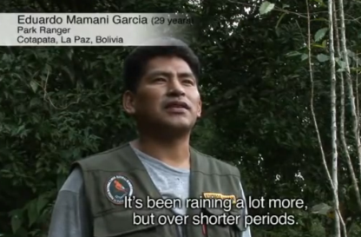
IMPACTS OF CLIMATE CHANGE ON VULNERABLE PEOPLE
CASE 2: Changing rainfall patterns in Bolivia
Key point: Shift to less climate-sensitive activities
Notes:
Notes for trainers:
Case 2 video: http://youtu.be/OruIaPiFFHc0
Key points from the video:
Shift to less climate-sensitive activities
Climate change may cause changing rainfall patterns leading to lower yields.
A farmer became a road worker because the yields are not reliable anymore.
Agriculture is a climate-sensitive activity, strongly affected by climate change and variability. If people change to less climate-sensitive activities their incomes become more reliable.

Slide 9


CLIMATE CHANGE AND FOOD SECURITY DIMENSIONS
A small business in Honduras sells industrial food products. A severe storm hit the state and her home is also affected.
Indicate the affected food security dimension (Availability, Access or Utilization):
Food stored for consumption and sale got damaged.
As a consequence of the storm, local market prices for many food items have gone up. To manage the food needs after the devastating storm the owner decides to buy other, cheaper products from the global market.
The diet of the owners family became unbalanced due to the lower quality of cheap products.
Notes:
Notes for trainers:
Climate change impacts all the dimensions of food security of vulnerable groups.
*Suggested activity: ask learners to do this exercise.
Answer: 1 availability, 2 access, 3 utilization
Food security dimensions
The definition of food security used in this course is the one adopted at the 1996 World Food Summit held in Rome:
Food security exists when all people, at all times, have physical and economic access to sufficient, safe and nutritious food that meets their dietary needs and food preferences for an active and healthy life.
This definition introduces four main “dimensions” of food security:
physical availability of food, which addresses the “supply side” of food security and is determined by the level of food production, stock levels and net trade;
the economic and physical access to food, including incomes and access to markets;
the food utilization, i.e. the way the body makes the most of various nutrients in the food, which is influenced by people’s health status;
the stability of food security (“at all times” ), which emphasizes the importance of having to reduce the risk of adverse effects on the other three dimensions.
Comment: The business experienced lost of stored, available food; difficulties in buying food at the market due to price increase; and worsening of family diet.

Slide 10
A poor farmer in Central Benin cannot afford to buy chemical fertilizer and has no access to irrigation.
His income and food security heavily depend on good crop yields which are highly variable due to harsh climate conditions in the subhumid savannah zone.
CLIMATE CHANGE AND FOOD SECURITY DIMENSIONS
Which dimension of food security is affected by each impact?
The price of stock fish at the local market increases significantly.
This is probably due to heat stress in the ponds affecting fish growth
Recent harvests of yam have been poor due to more frequent droughts. This year the onset of the rainy season is later than usual.
The farmer is hit more often by Malaria and Diarrhea, both of which are favoured by higher temperatures. The illness reduces his body's ability to absorb nutrients from the food.
Notes:
Notes for trainers:
Both extreme events and gradual changes in climatic conditions can reduce food security.
*Suggested activity: ask learners to do this exercise.
Answer: 1 access, 2 availability, 3 availability, 4utilization
Comment: The farmer has experienced: difficulty in buying food due to price increases; decreased quantity and quality of available food; and health problems.

Slide 11
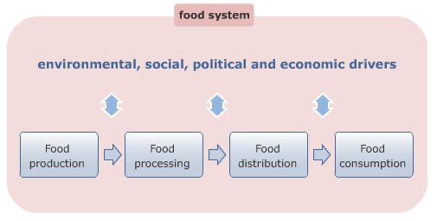
CLIMATE CHANGE IMPACTS ON FOOD SYSTEMS
Notes:
Notes for trainers:
Effects of climate change go beyond individual households.
To understand the effects on food security in a country or a region, the “food system” concept is useful.
In a narrow sense, a food system is a set of activities from production through to consumption.
Example: Think about cassava flour: someone has to grow cassava (production), dry, mash and package it (processing), deliver it to a market (distribution), where someone buys and eats it (consumption). Food systems go beyond individual food products.
In a broader sense, a food system also includes interactions with environmental and socio-economic drivers.
Example: For example, a population could become food insecure, when the supply of cassava flour is not an issue, but it doesn’t reach consumers because of poverty, conflicts or a flashflood which destroyed roads in a country.

Slide 12
CLIMATE CHANGE IMPACTS ON FOOD SYSTEMS
Effects on food systems in West Africa
There are estimates that by the middle of the 21st century climate change impacts could reduce maize production in West Africa.
Yields of traditional crops, such as cassava, will be less affected by climate change, because of its ability to achieve at least some yield in the worst weather years.
Unfortunately, such crops are also very poor sources of protein and micronutrients, and if farmers favor them relative to cereals, nutrient consumption could decline.
In West Africa drying is a key component of most of the food storage techniques used in the region. Extreme dryness could aid processing and storage, while flooding and cold conditions may substantially hamper them. Also, flood-related damages to roads and warehouses could make it difficult to transport food to consumers. In some locations, breakdown of electricity grids may make it harder to process food.
Notes:
Notes for trainers:
Climate change is one of the environmental drivers interacting with a food system.
It will affect not only food production, but also food processing, distribution and consumption.
Please have a look at the Case study: Effects on food systems in West Africa

Slide 13
CLIMATE CHANGE IMPACTS ON FOOD SYSTEMS
Which dimension of food system activities (food production, food processing, food distribution, food consumption) is affected by
each impact?
Impacts:
Flooding and cold conditions may substantially hamper food storage.
Farmers might favor cassava crops relative to cereals as they are less affected by climate change.
The population would eat more cassava which is a very poor source of protein and micronutrients.
Flood-related damages to roads and warehouses could make it difficult to transport food.
Notes:
Notes for trainers:
*Suggested activity: ask learners to do this exercise.
This exercise refers to the case study on the previous slide (Effects on food systems in West Africa).
Exercise
Identify the impacts of climate change on the different food system activities (food production, food processing, food distribution, food consumption).
Answer
2: Food production
3: Food consumption
4: Food distribution
Feedback:correct
These are some examples of how climate change can negatively affect food system activities.
1: Food processing

Slide 14

CLIMATE CHANGE IMPACTS ON FOOD SYSTEMS
Climate
Change
Climate change is not only an environmental driver, it is also influenced by food systems activities.
Food Systems
Food Systems
Climate
Change
Notes:
Notes for trainers:
Food systems are affected by climate change but at the same time contribute to climate change through the release of greenhouse gases.
Next lesson will deal with strategies that can be adopted to address the effects of climate change on food systems, as well as to reduce the emissions of greenhouse gases which contribute to climate change.

Slide 15


SUMMARY
Climate change has significant implications for agriculture and food security, creating new risks and challenges and exacerbating existing vulnerabilities from the local to the global level.
Rural livelihood systems and poor or marginalized groups that mainly depend on agriculture, forestry, fishery sectors, are the most vulnerable and strongly affected by climate change.
Climate change can affect all dimensions of the food security of vulnerable groups as well as different elements of food systems.
Climate change and food security are twin challenges which need to be addressed together.

